Slide 1
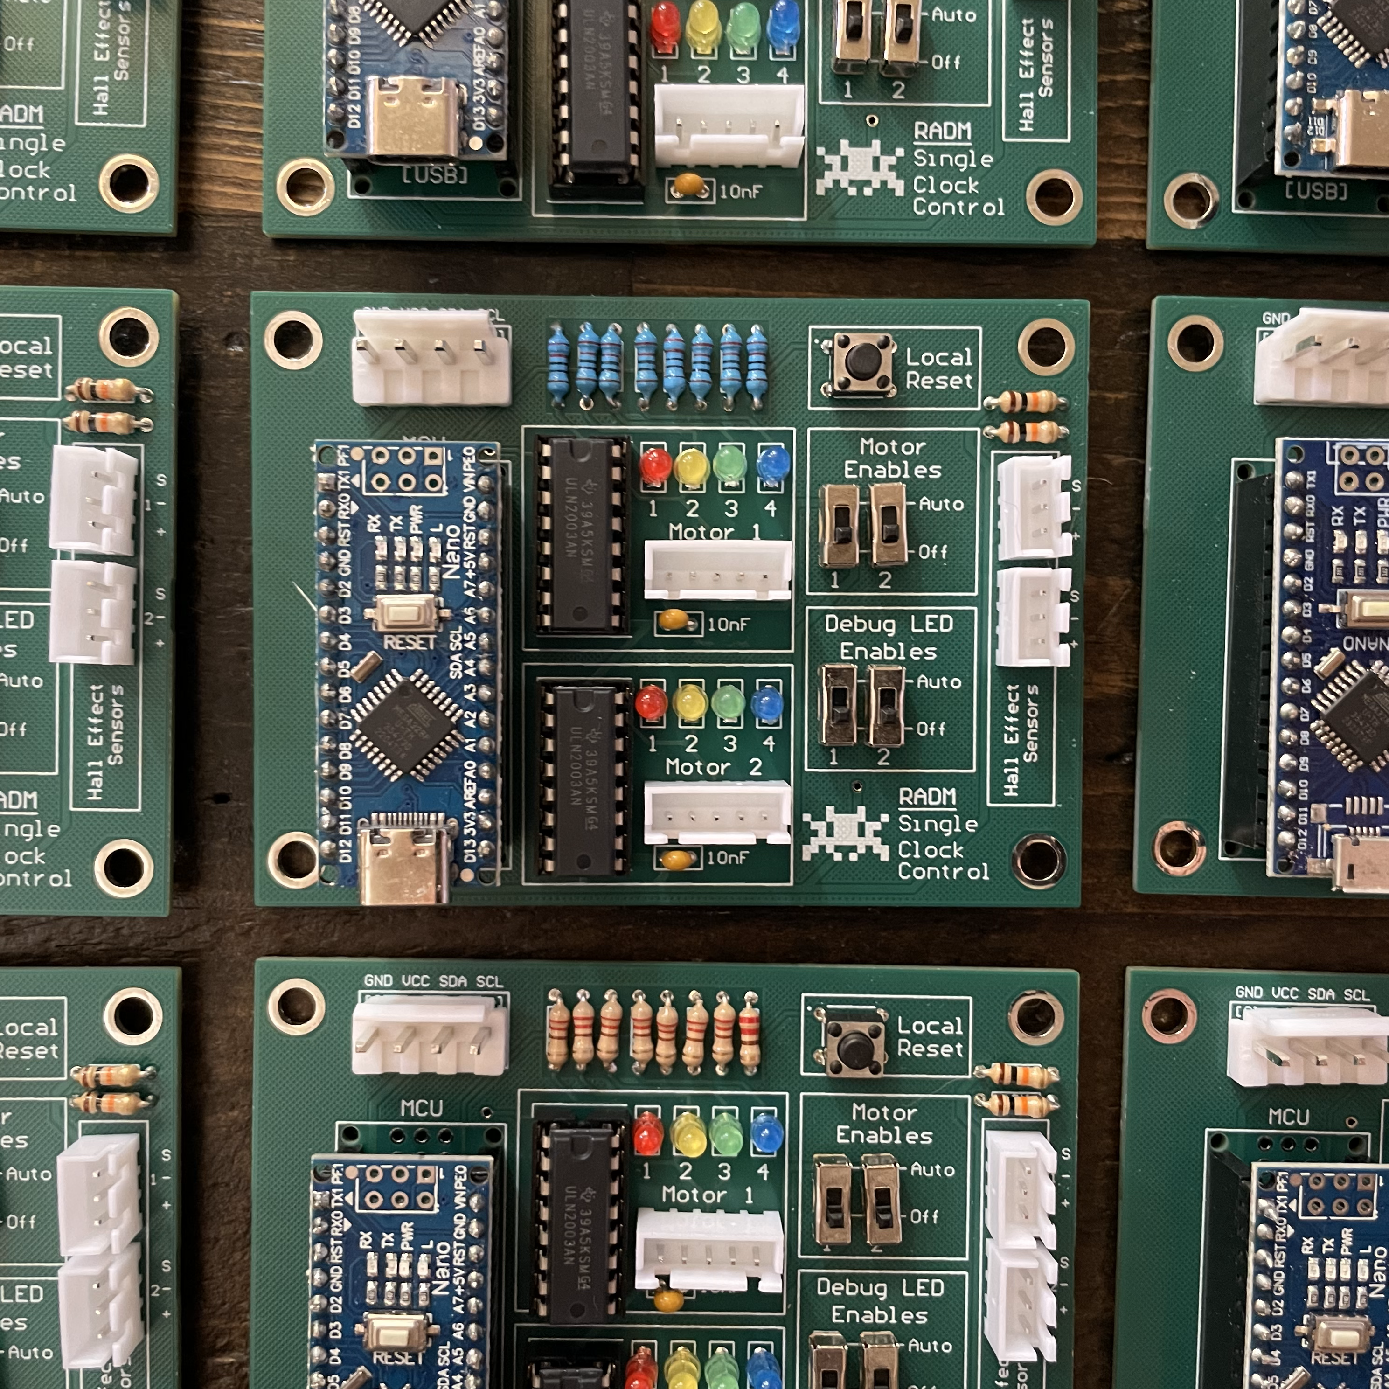
Clock Update!

Slide 2
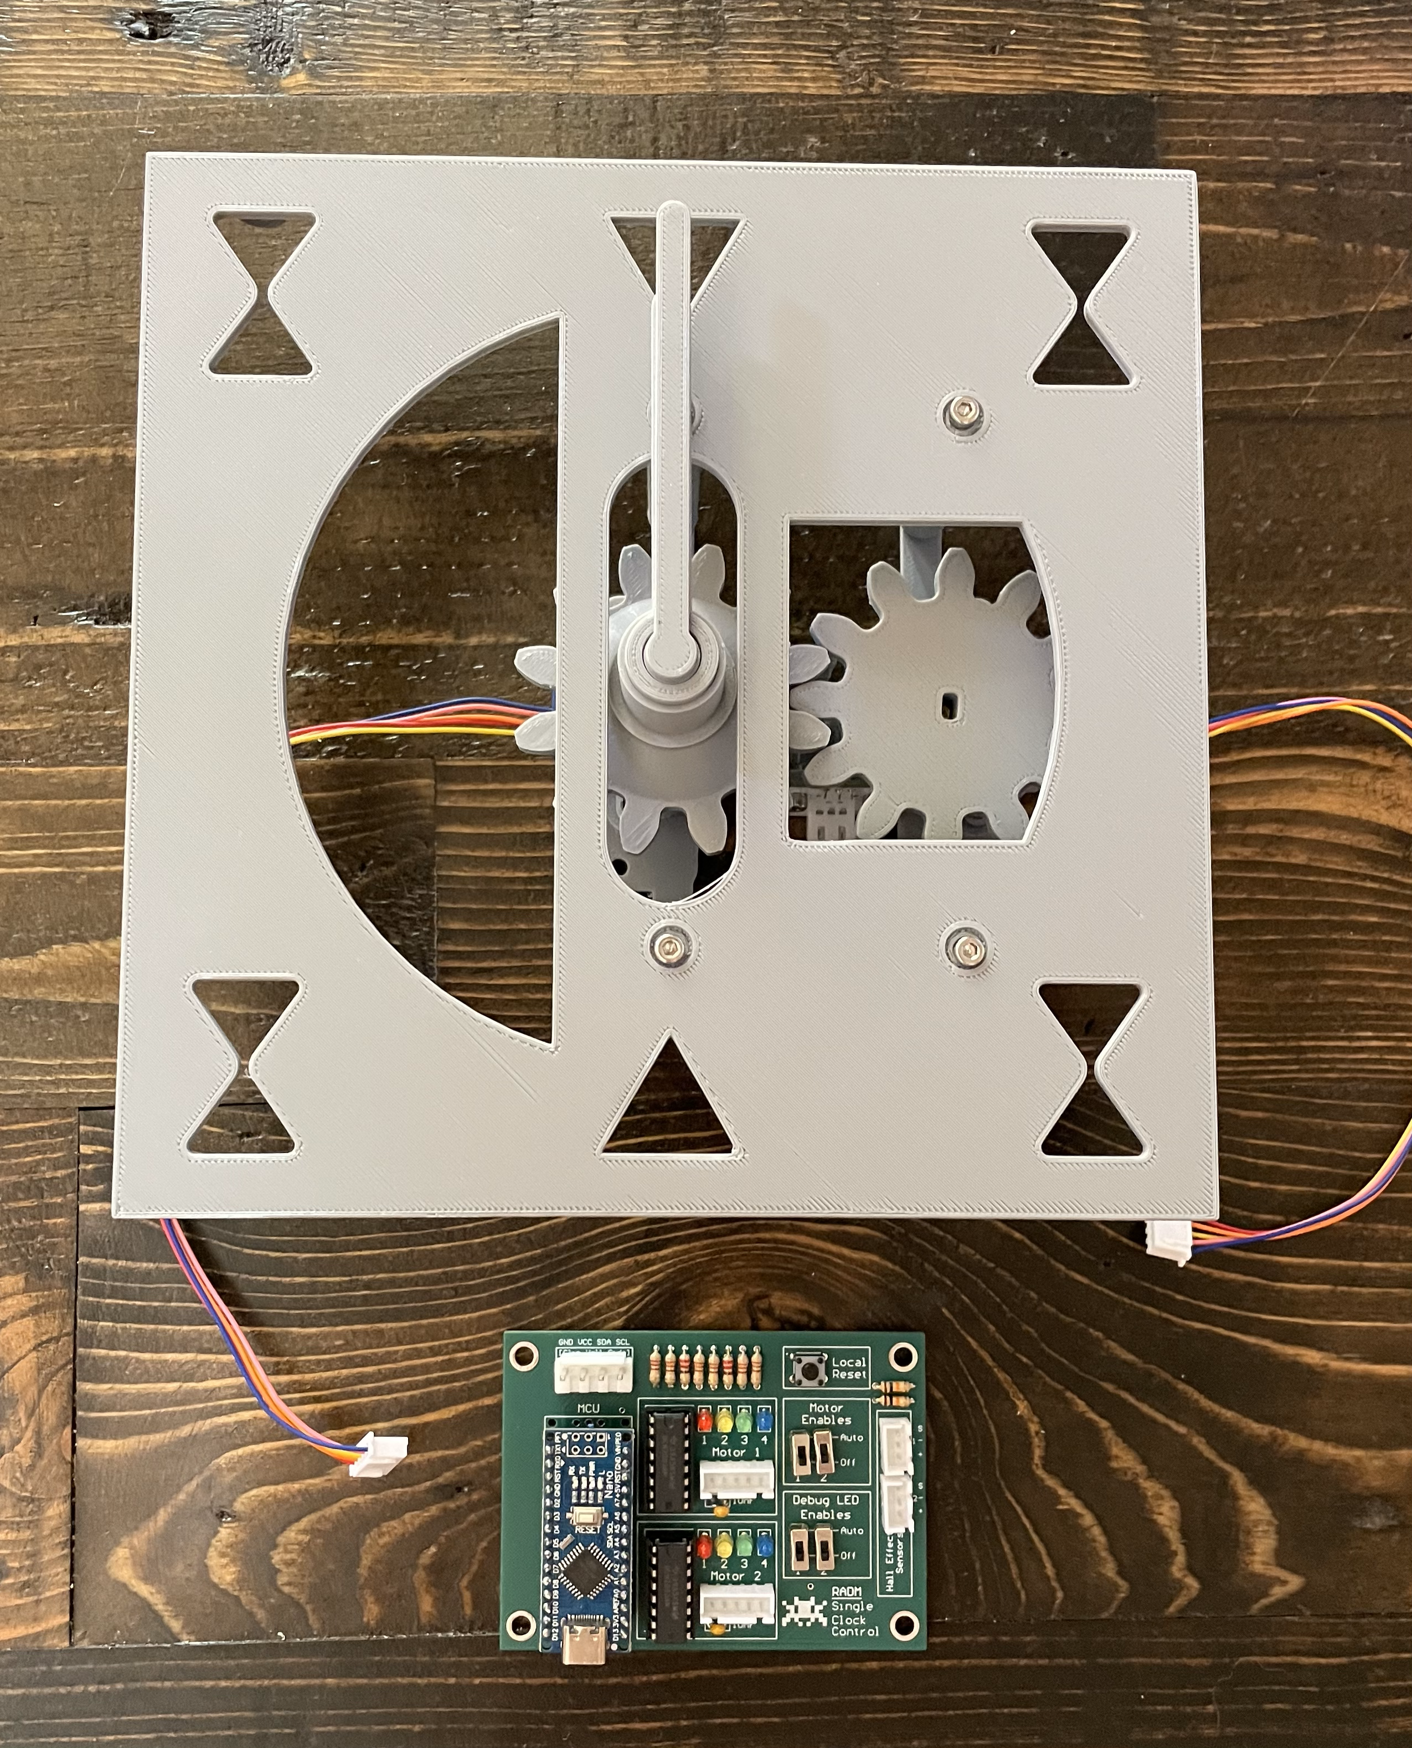
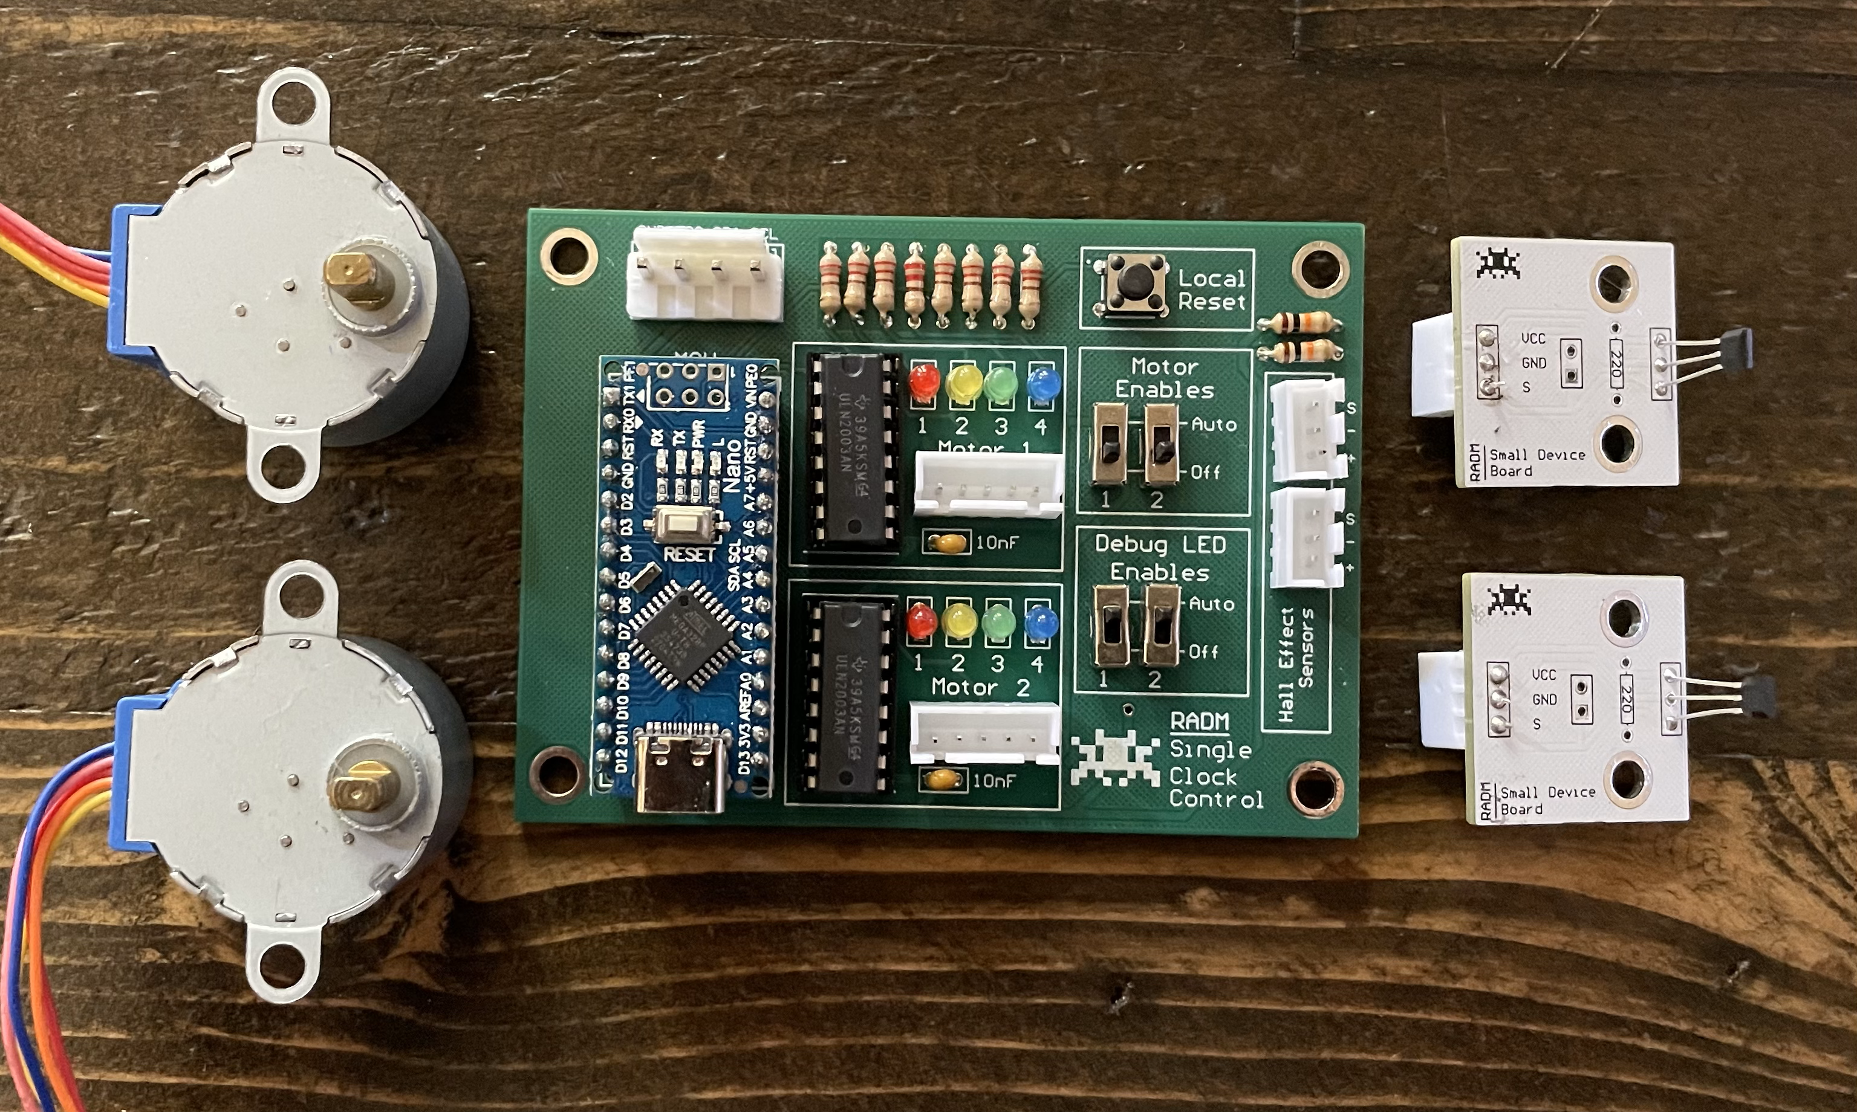
This is one clock.
Each clock has its own control board, two motors, and two Hall effect (magnet) sensors, not to mention a bunch of 3D printed parts.
Stepper motors
Hall effect sensors

Slide 3
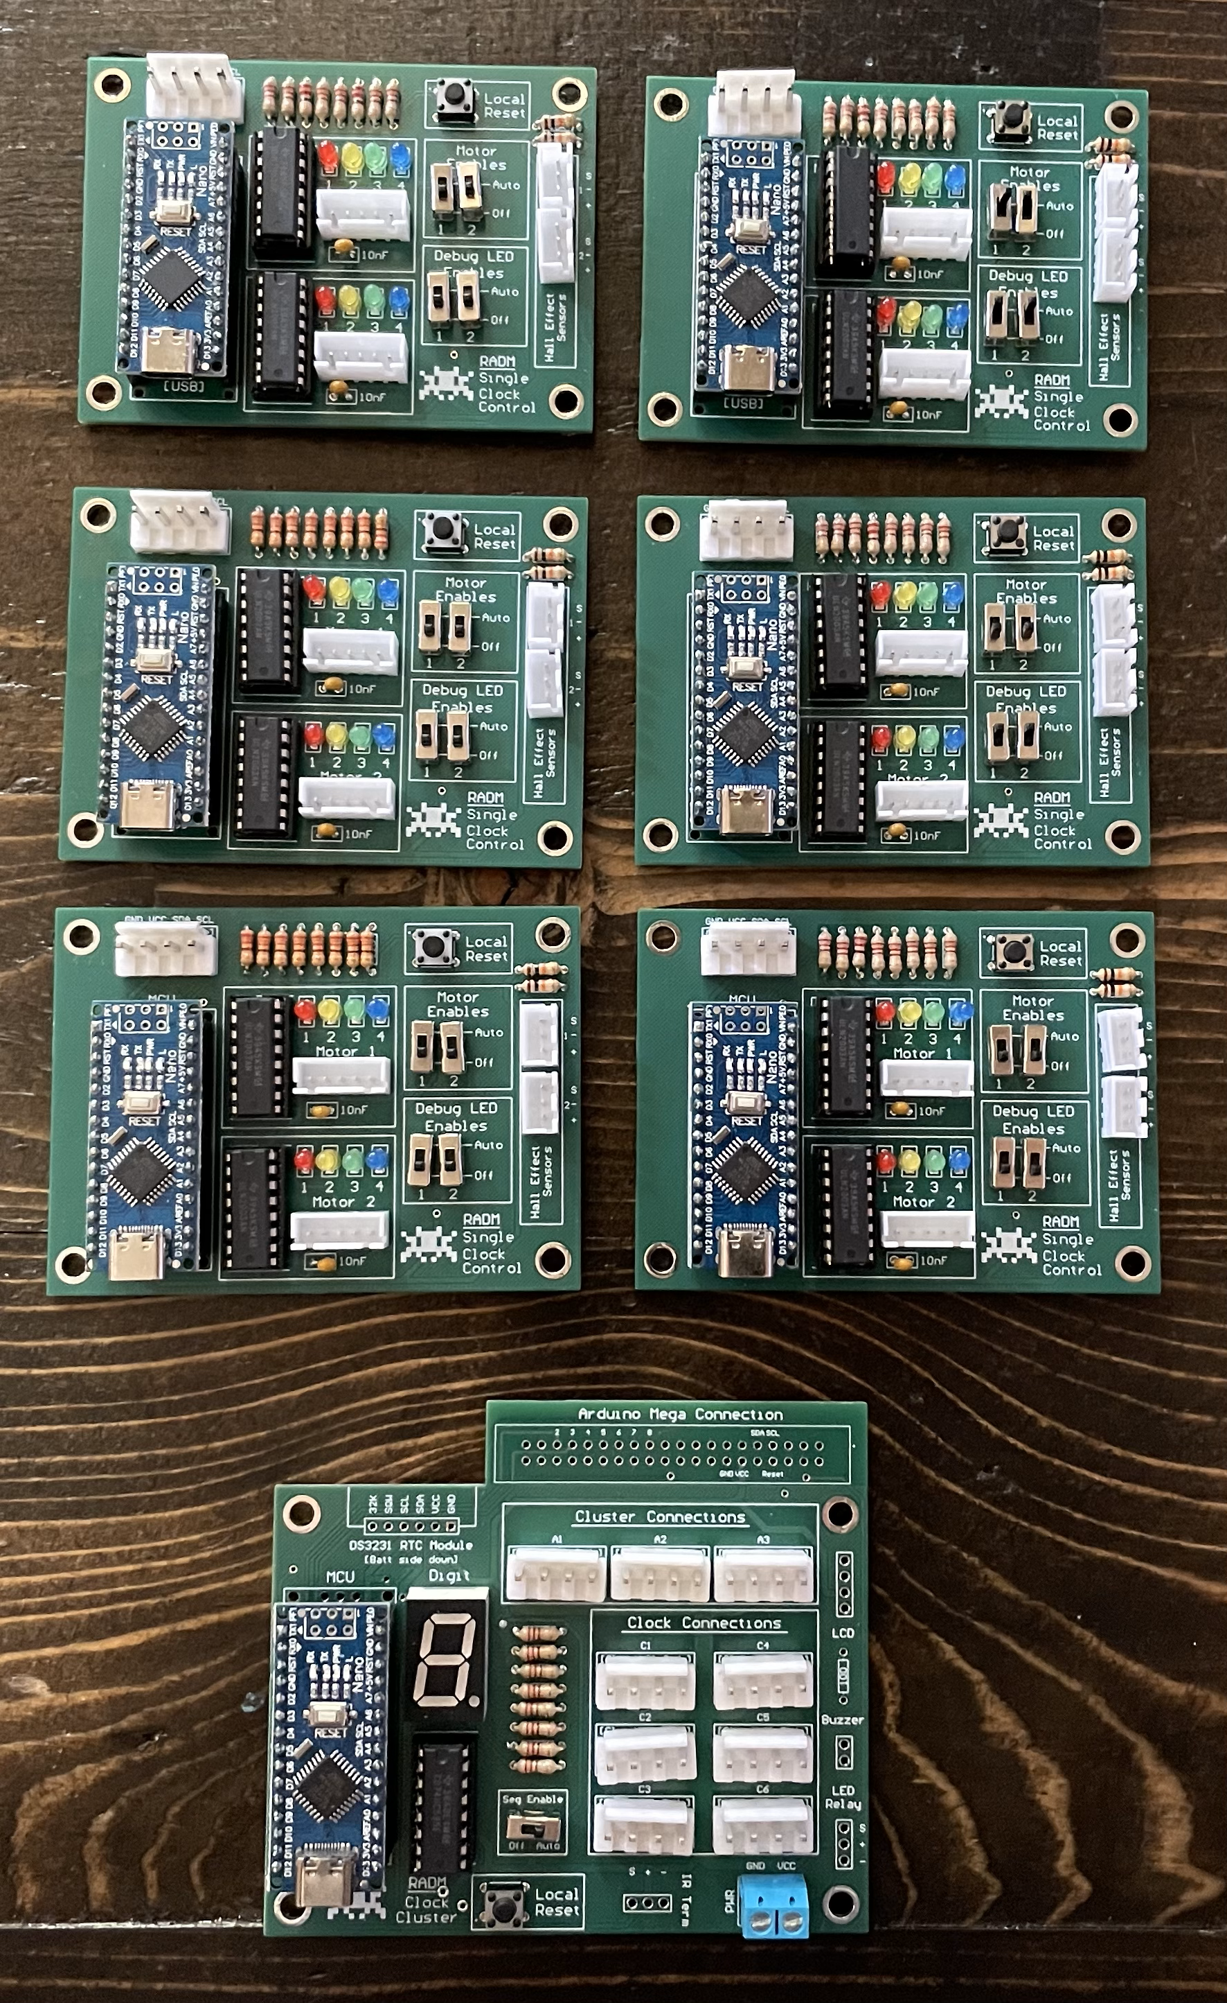
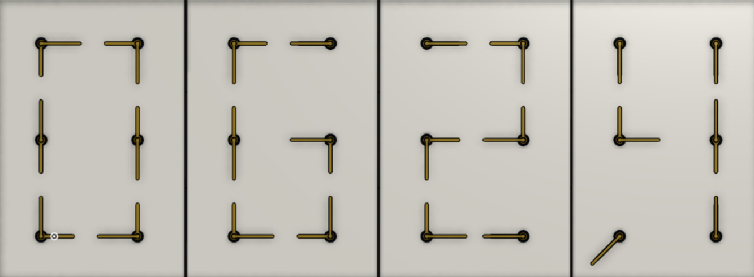
Six clocks make one segment.
Using six clocks, you can make a “digital” number with an analog display.
Each segment gets its own control board. This helps route power and data to each clock.

Slide 4
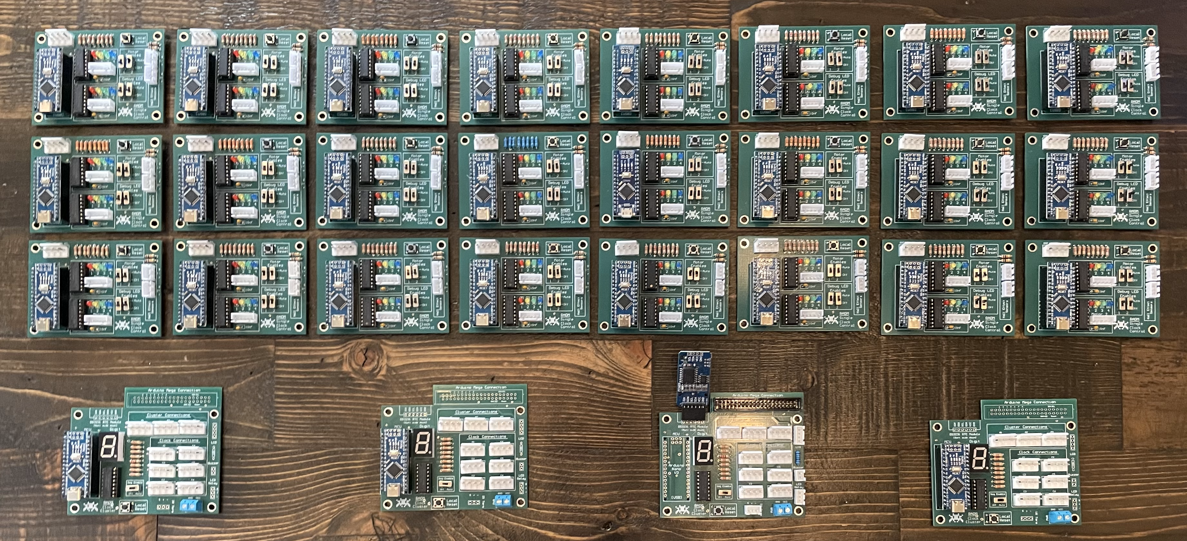
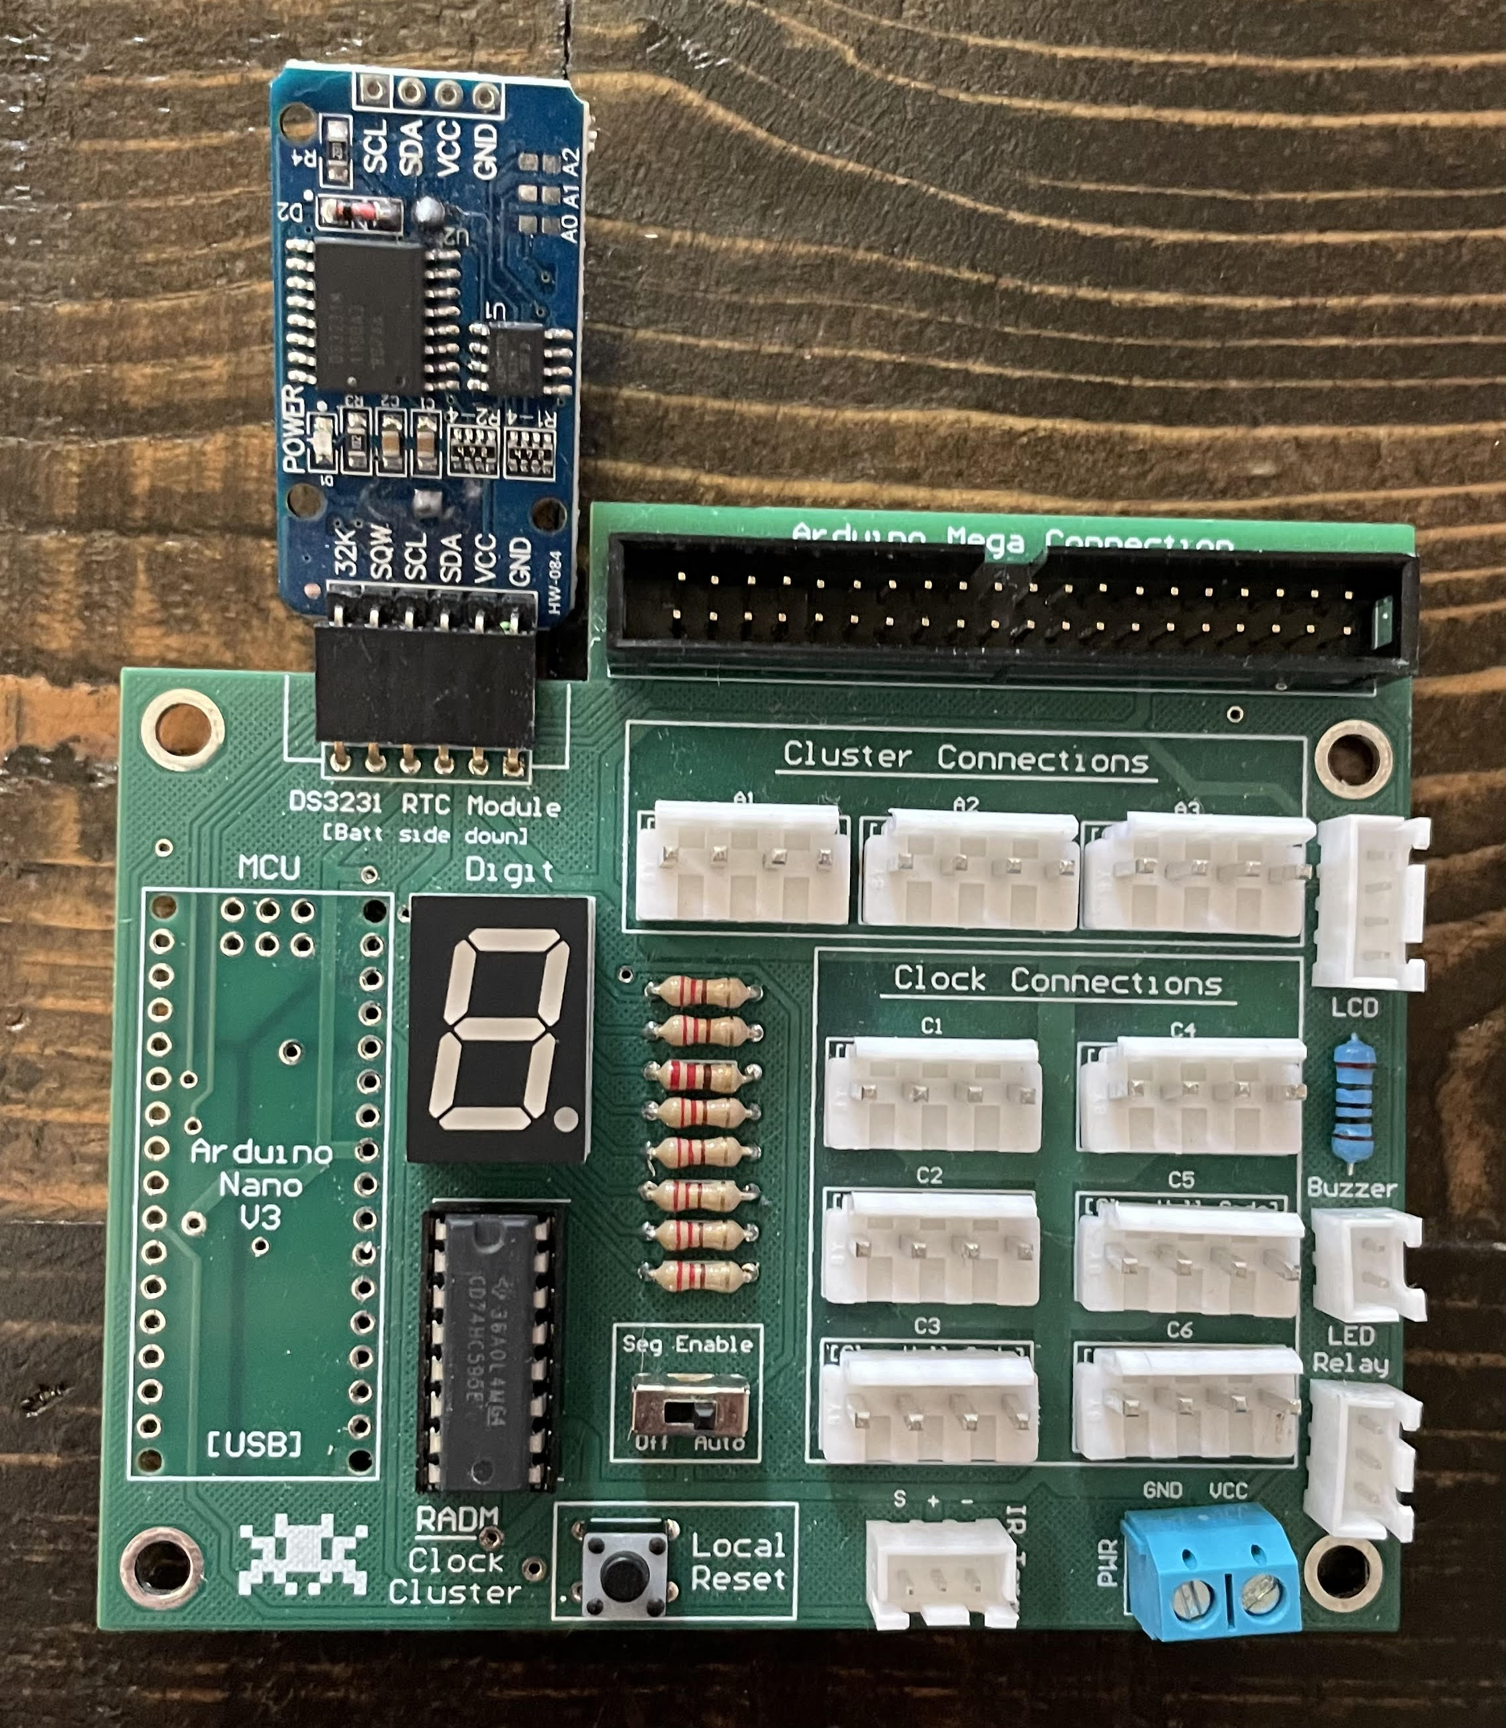
Four segments = 24 clocks.
One of the four segment control boards gets some extra circuitry. This board is the brain of the entire system and commands all the other boards.

Slide 5
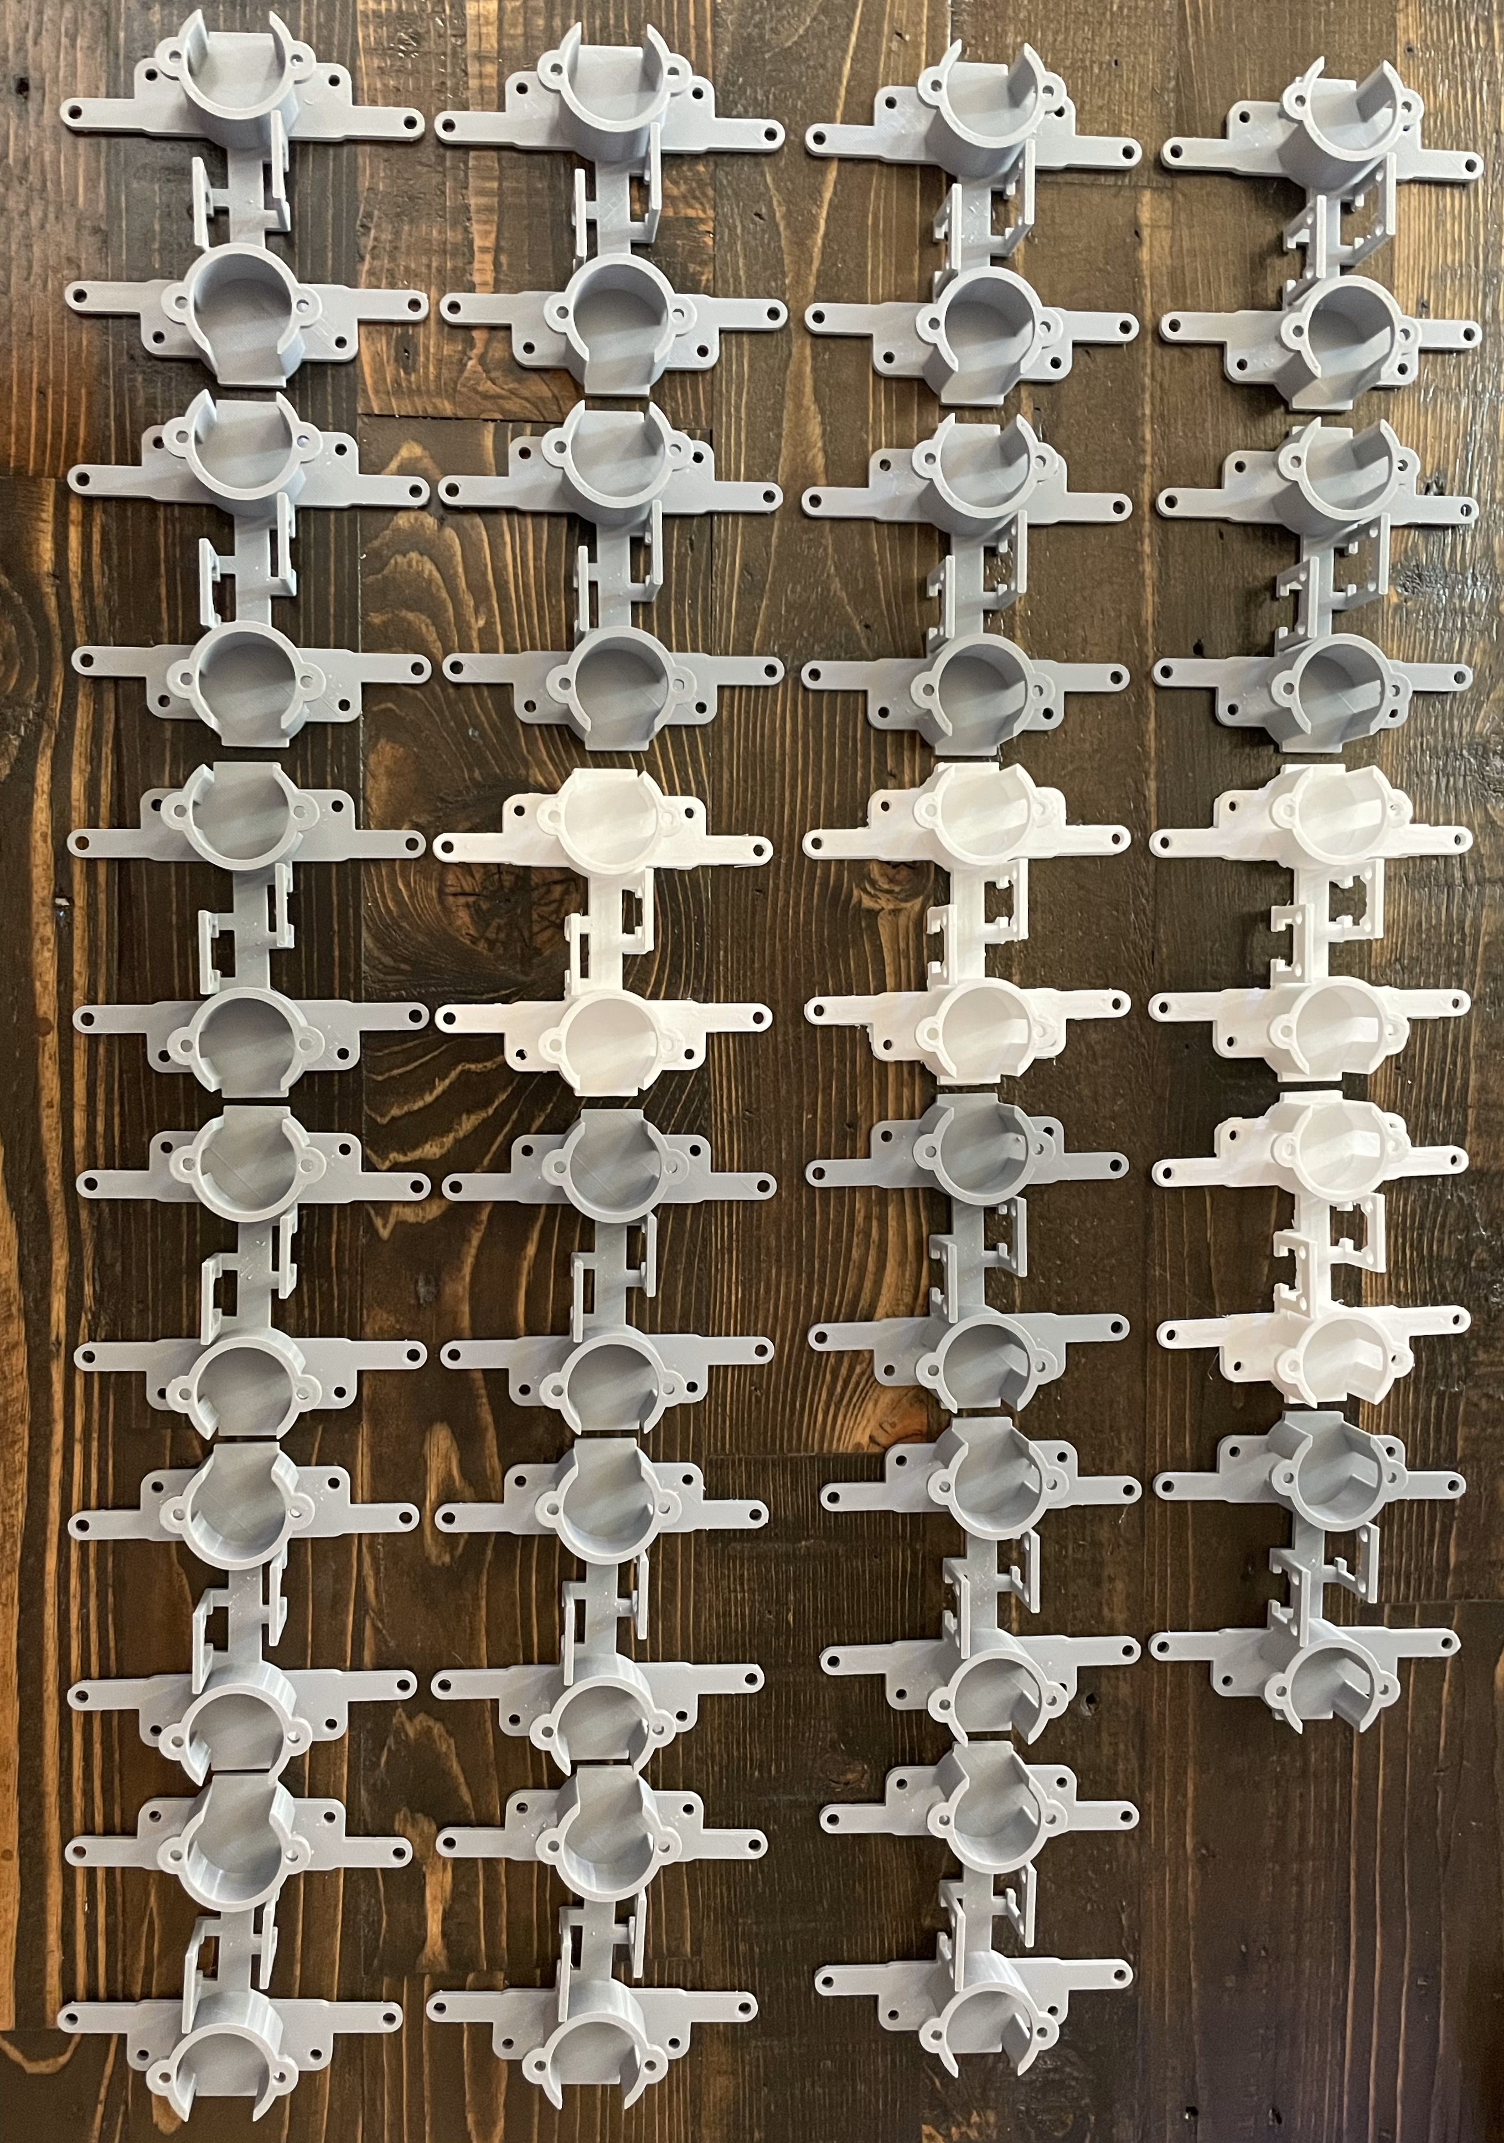
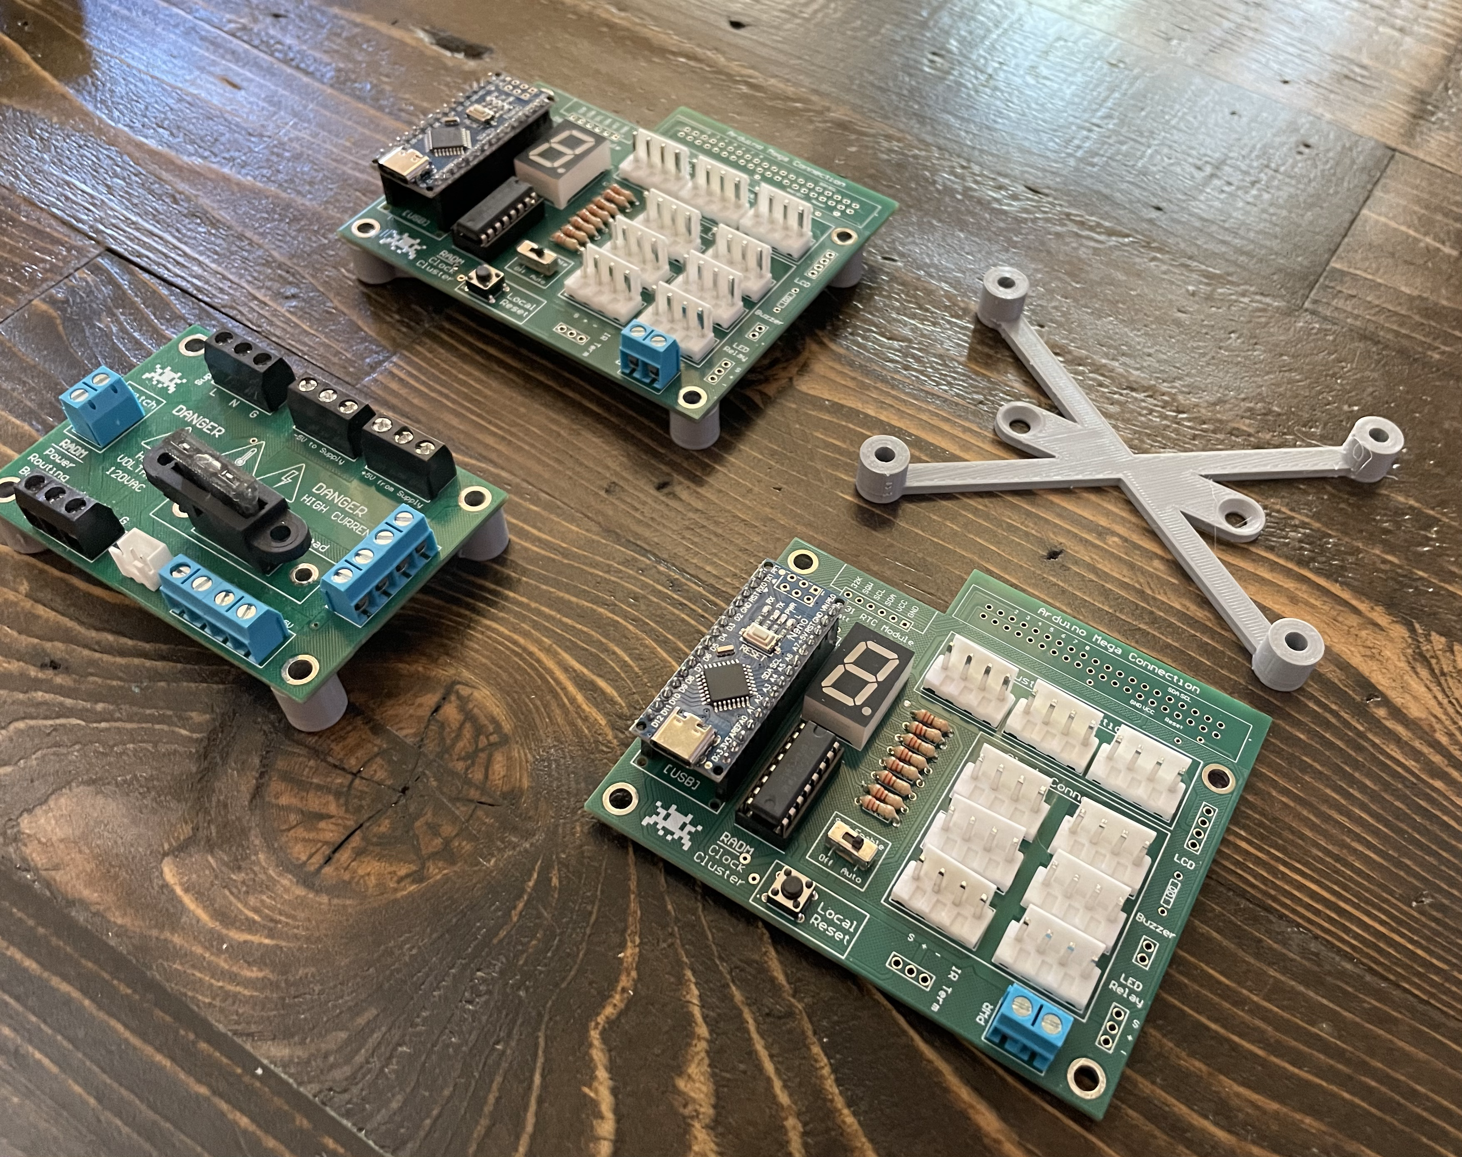
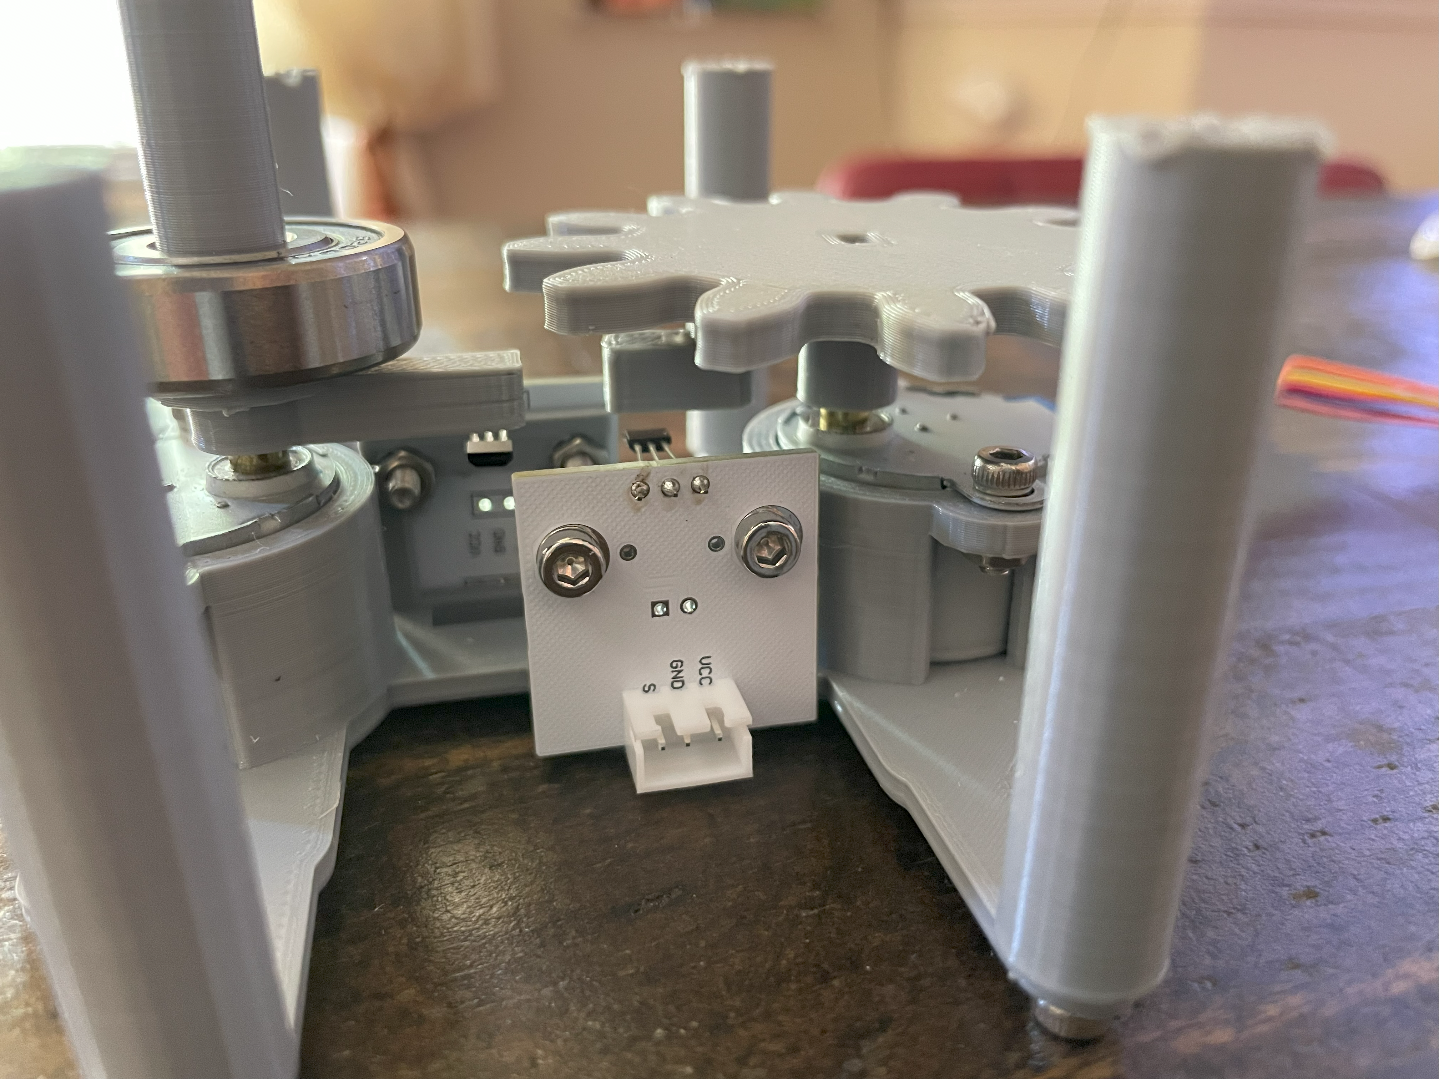
Lots of 3D printing
has been involved with this project. So far, this project has racked up nearly 200 hours of printing!

Slide 6
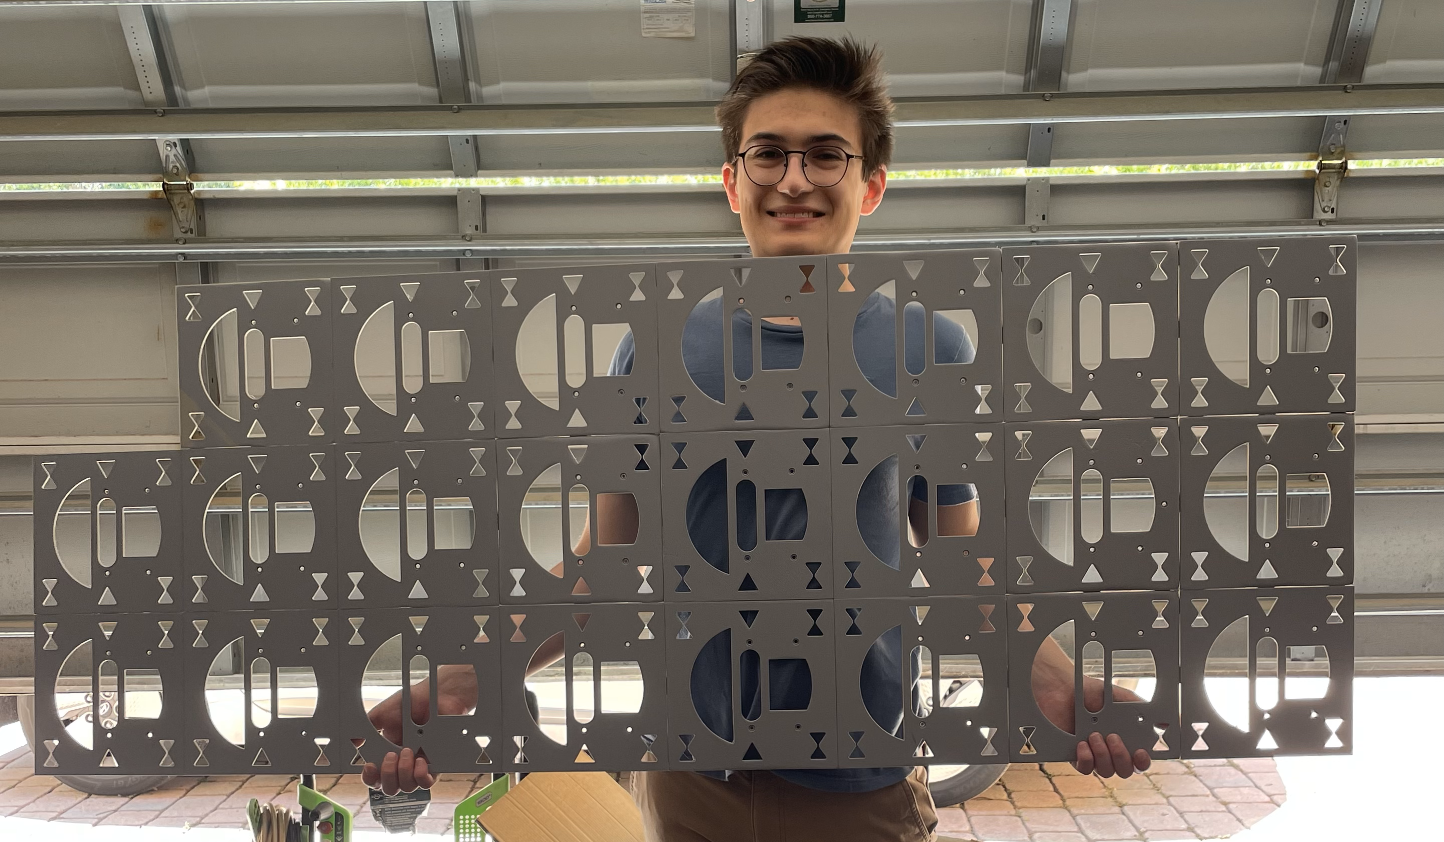
This thing is huge.
It’s hard to tell from the pictures, but this project is massive. On its side, the clock is about as tall as I am. The time, money, and scale involved with this is why it’s taking so long!

Slide 7
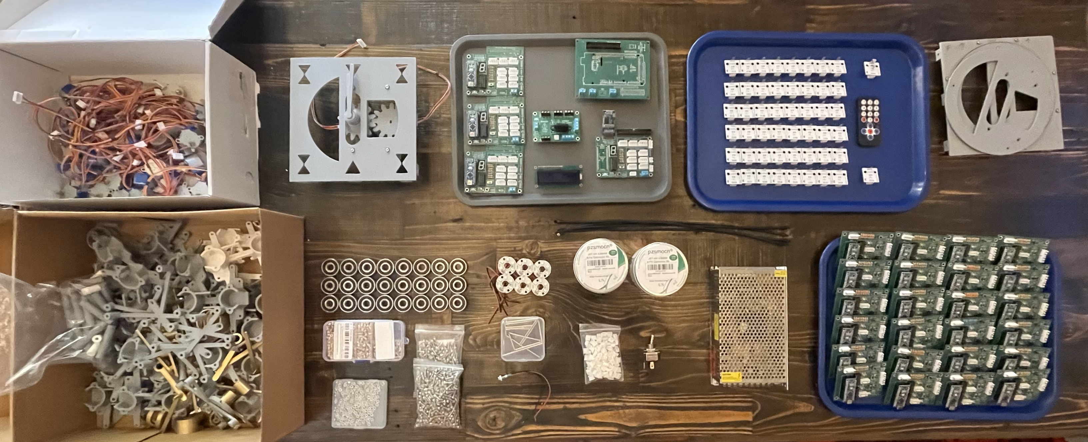

I’m almost done!
I’ve finished all the soldering and electronics work. My 3D printer broke while printing this (very tragic), and (of course) all that’s left is printing. I’m hoping to get all this done within the next two months. I’ll post more updates as it comes along!

